Slide 1
CIOs at UVA
Clown Computing © Est. 2018 L.L.C

Slide 2
Introduction
Goal: Accurately measure and predict the engagement levels of UVa students within CIOs based on given student and CIO attributes.
Data: Consisted of 34 columns, and 644 observations

Slide 3
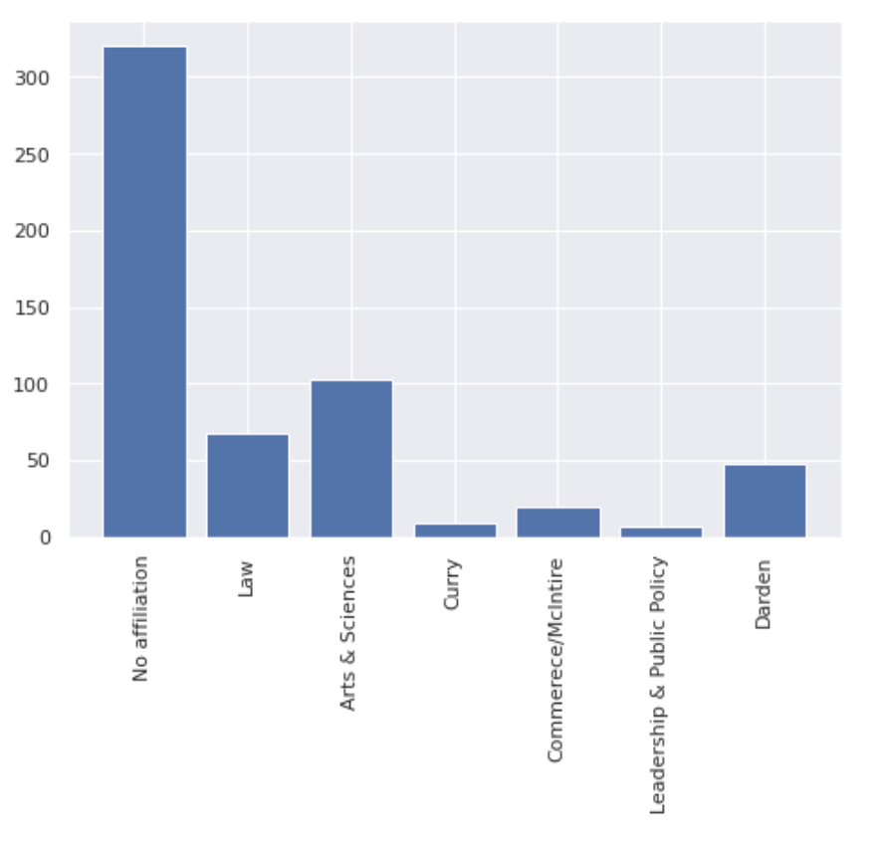
Affiliated School Distribution
Notes:
Xander

Slide 4
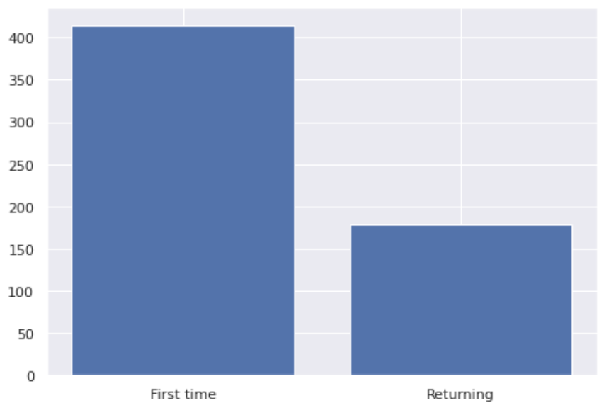
First Time President Count
Notes:
Xander

Slide 5
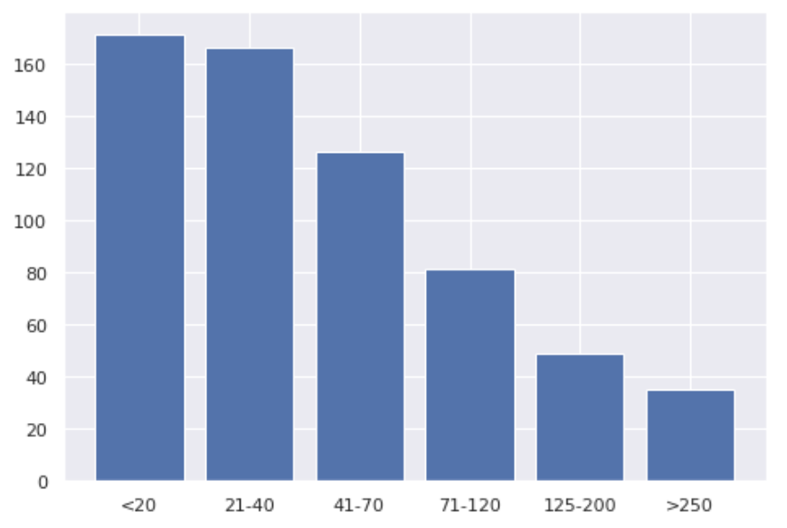
Distribution of Total Members
Notes:
Xander

Slide 6
Cleaning

Slide 7
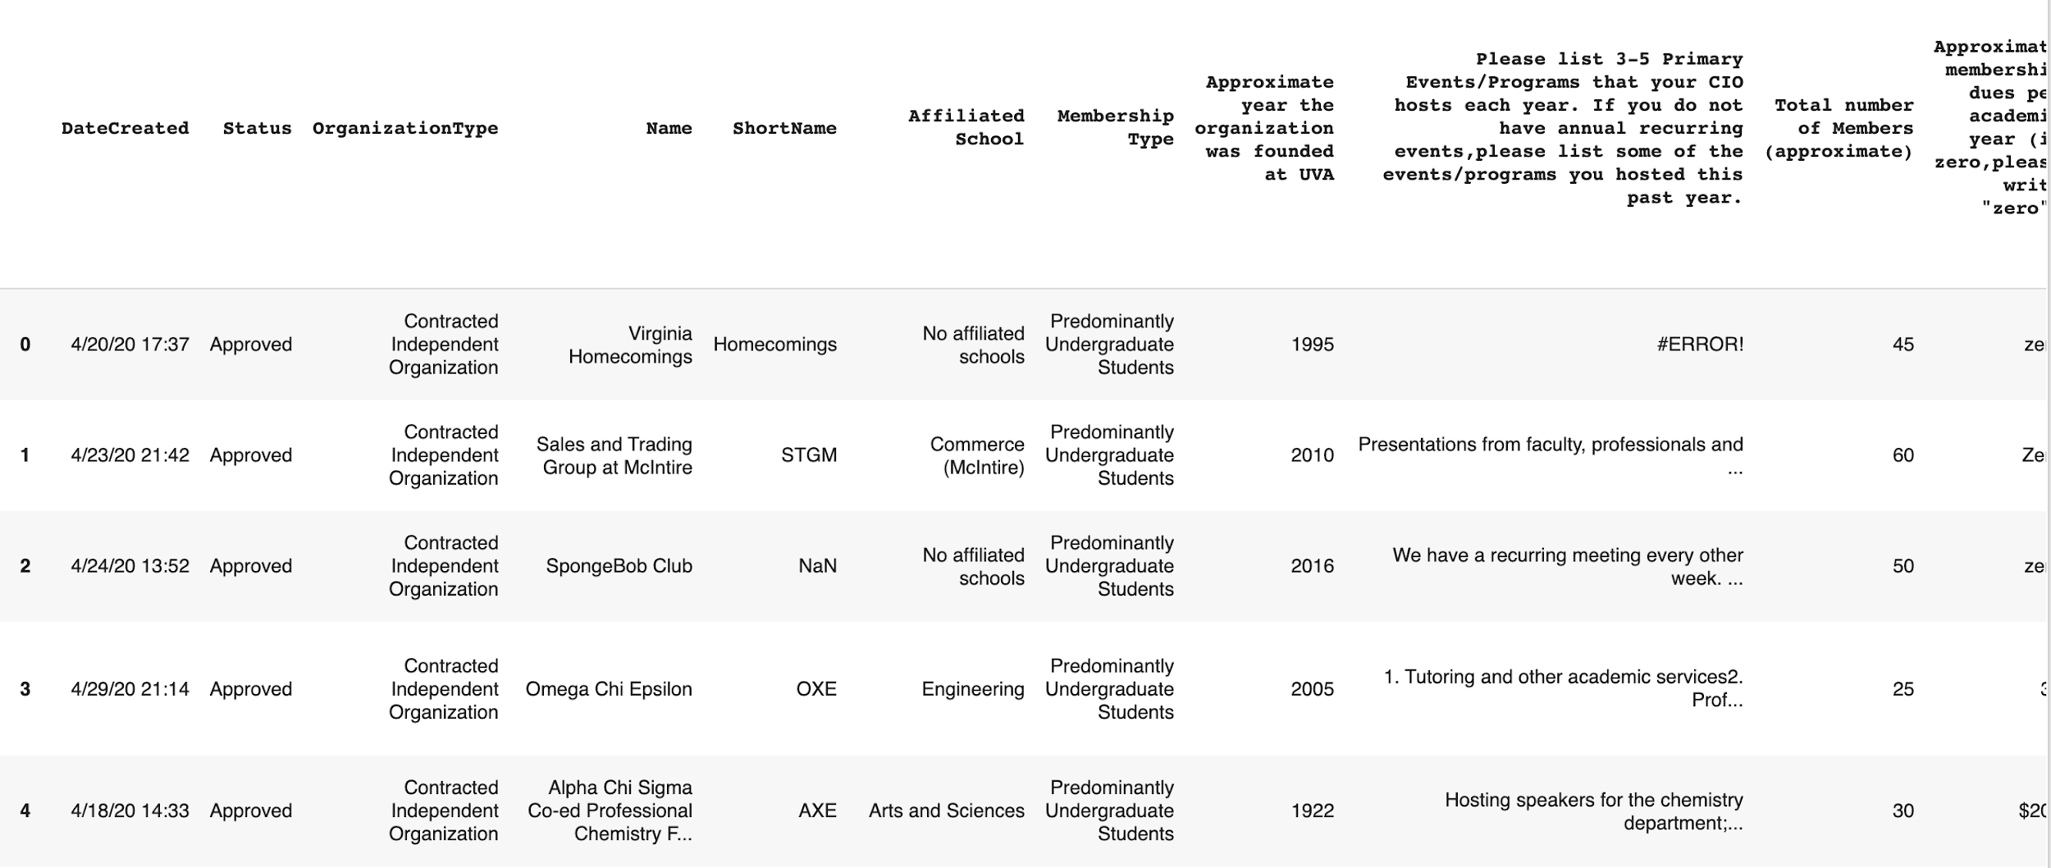
Cleaning
The data was not in a form where we could immediately do analysis
Old Data
Notes:
Ayoub

Slide 8
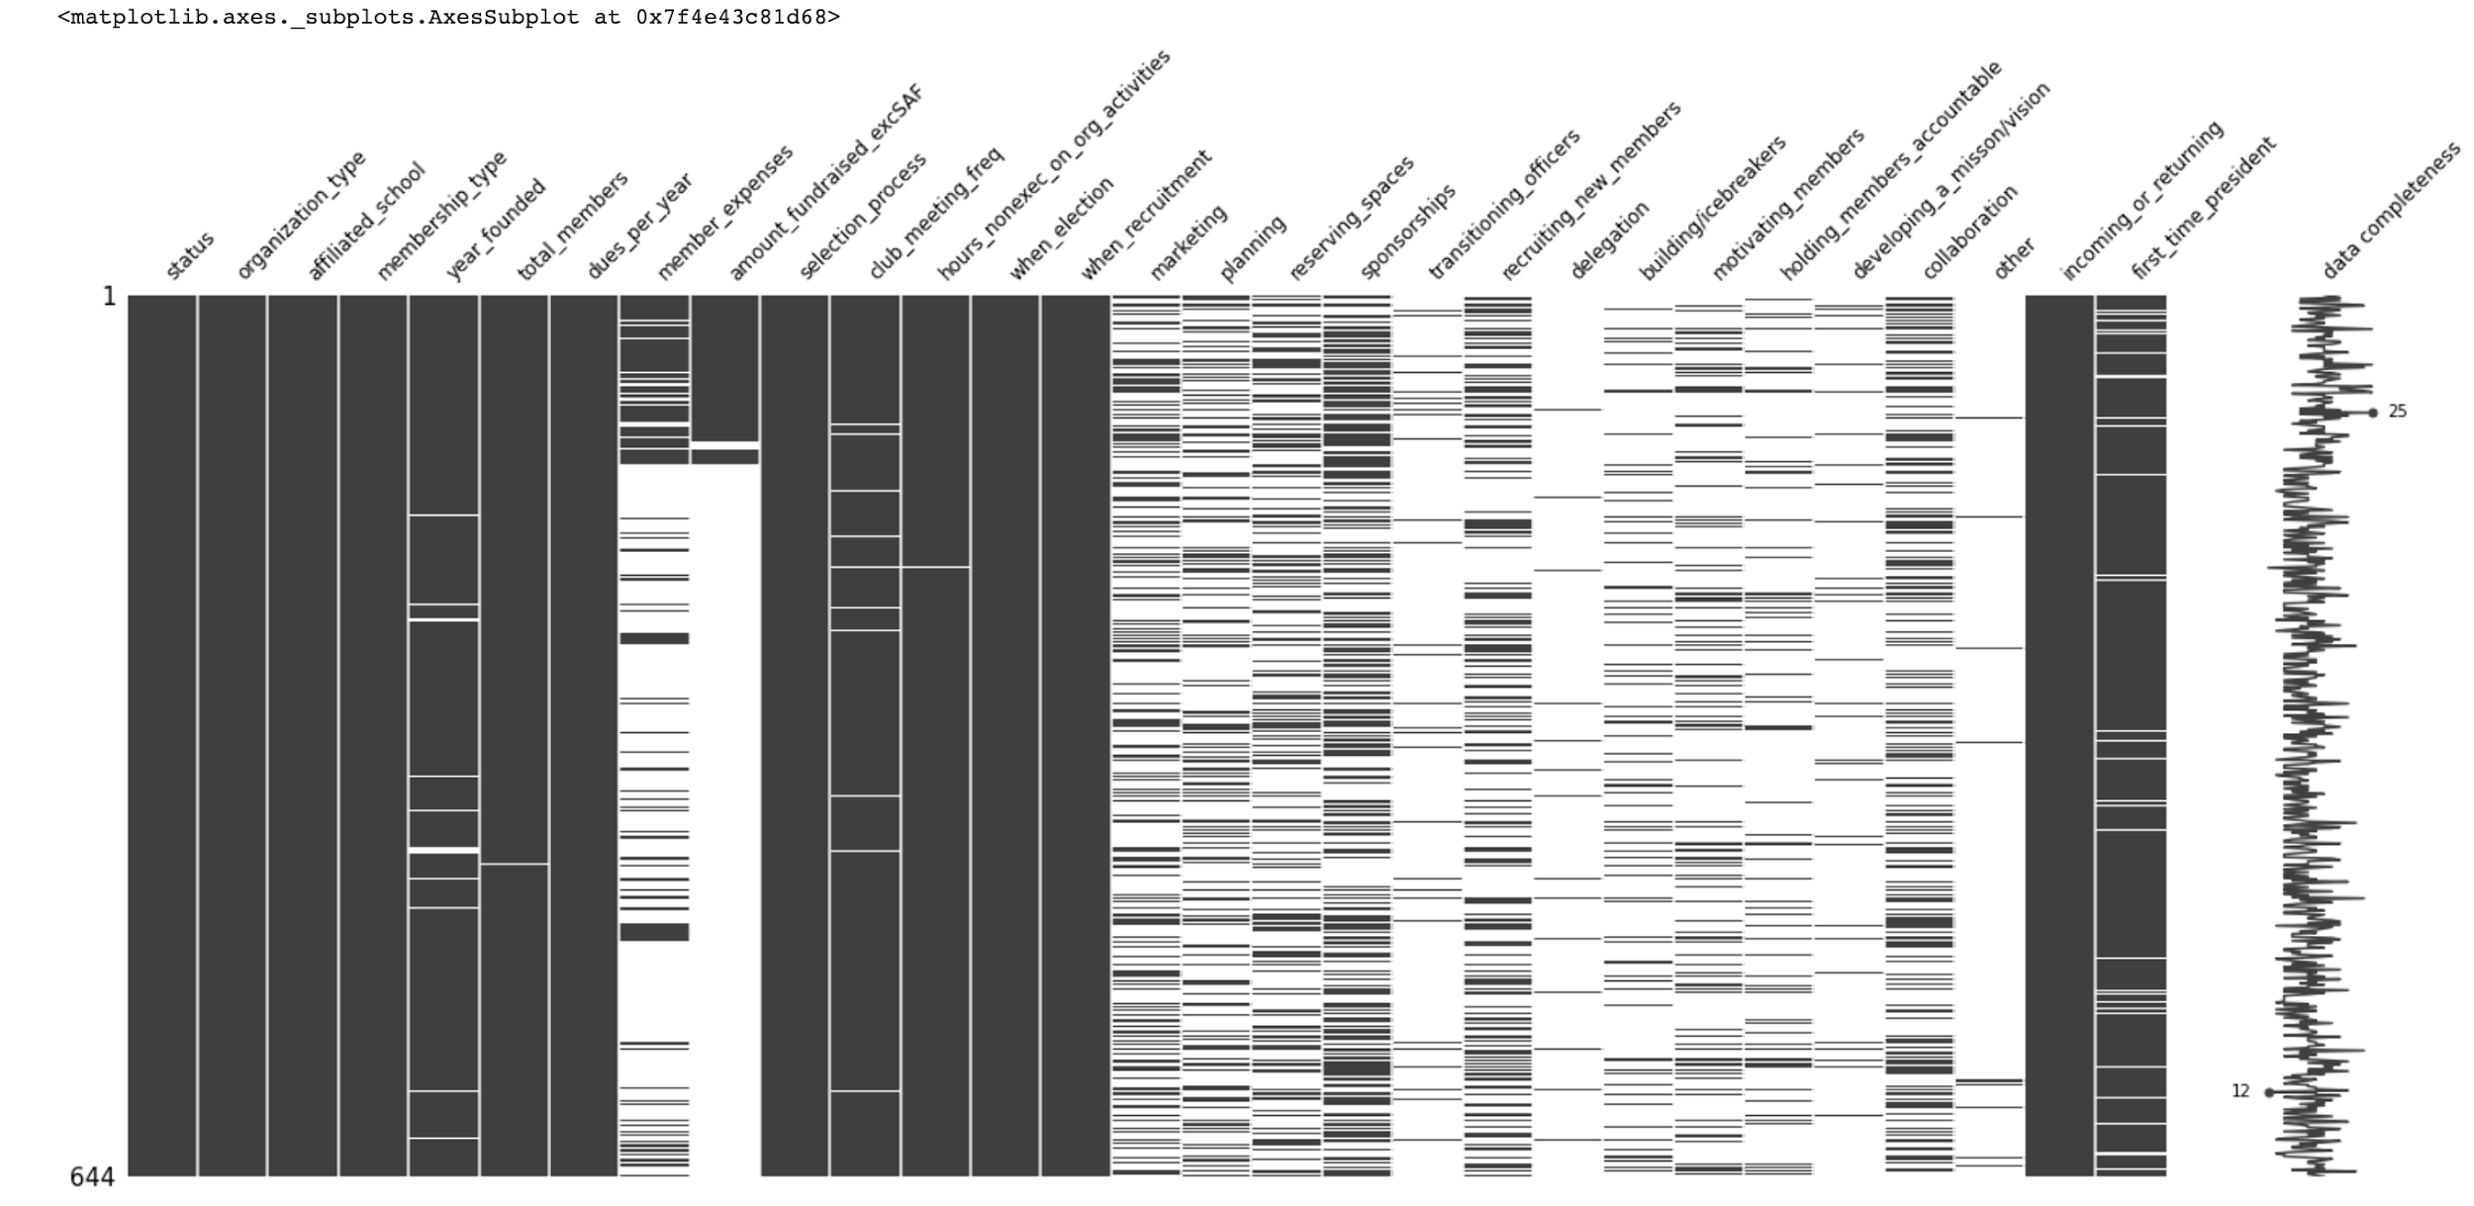
Notes:
Ayoub

Slide 9
Cleaning
Our aim was to do K-Means on the CIOs since a clear pattern could not be immediately identified in the dataset (if there was one).
We renamed the columns to shorter names
We dropped unnecessary columns like DateCreated and Name
We used try-except routines to change the data that could easily be corrected with code, then exported the edited data frame to a csv and cleaned it more there
Read the csv back in and prepared it for K-Means
Notes:
Ayoub

Slide 10
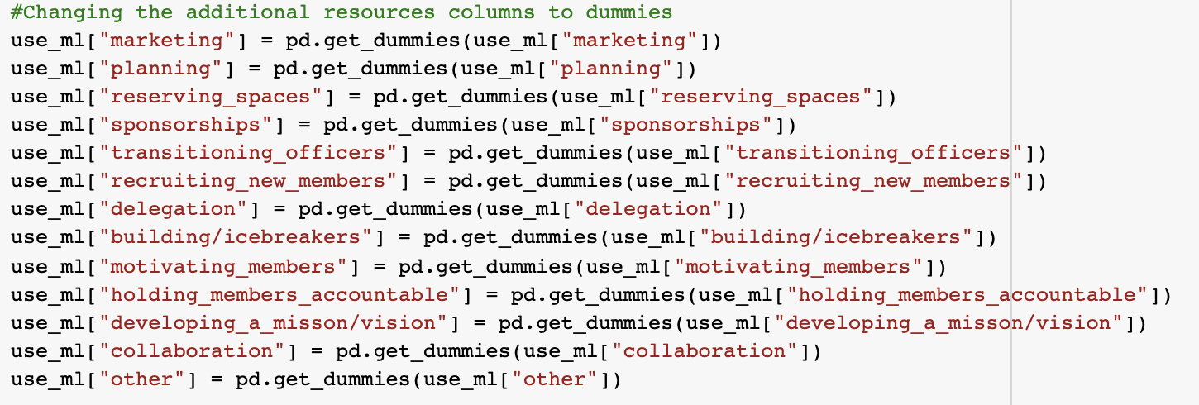
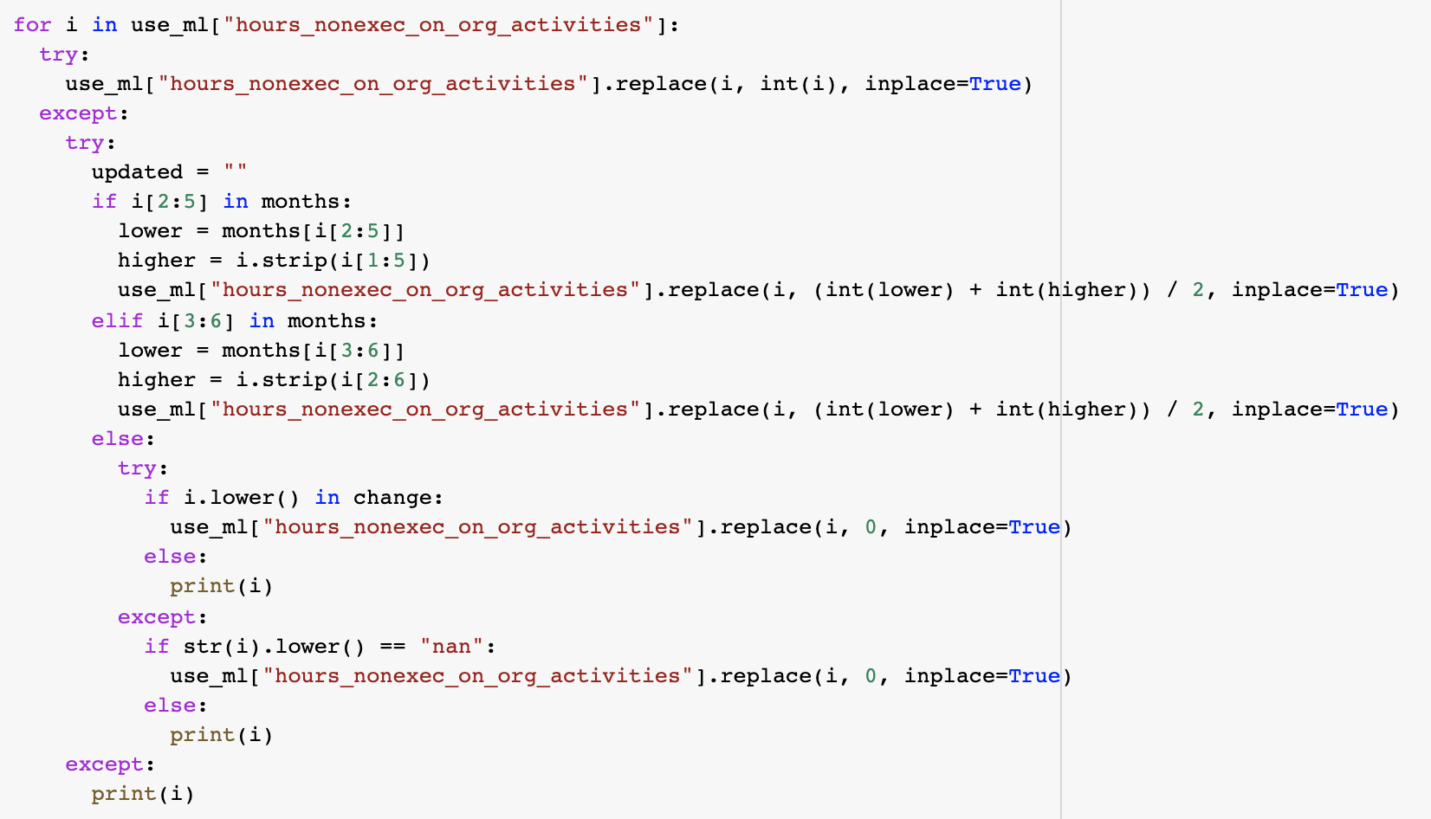
Code Examples for Cleaning
Notes:
Ayoub

Slide 11
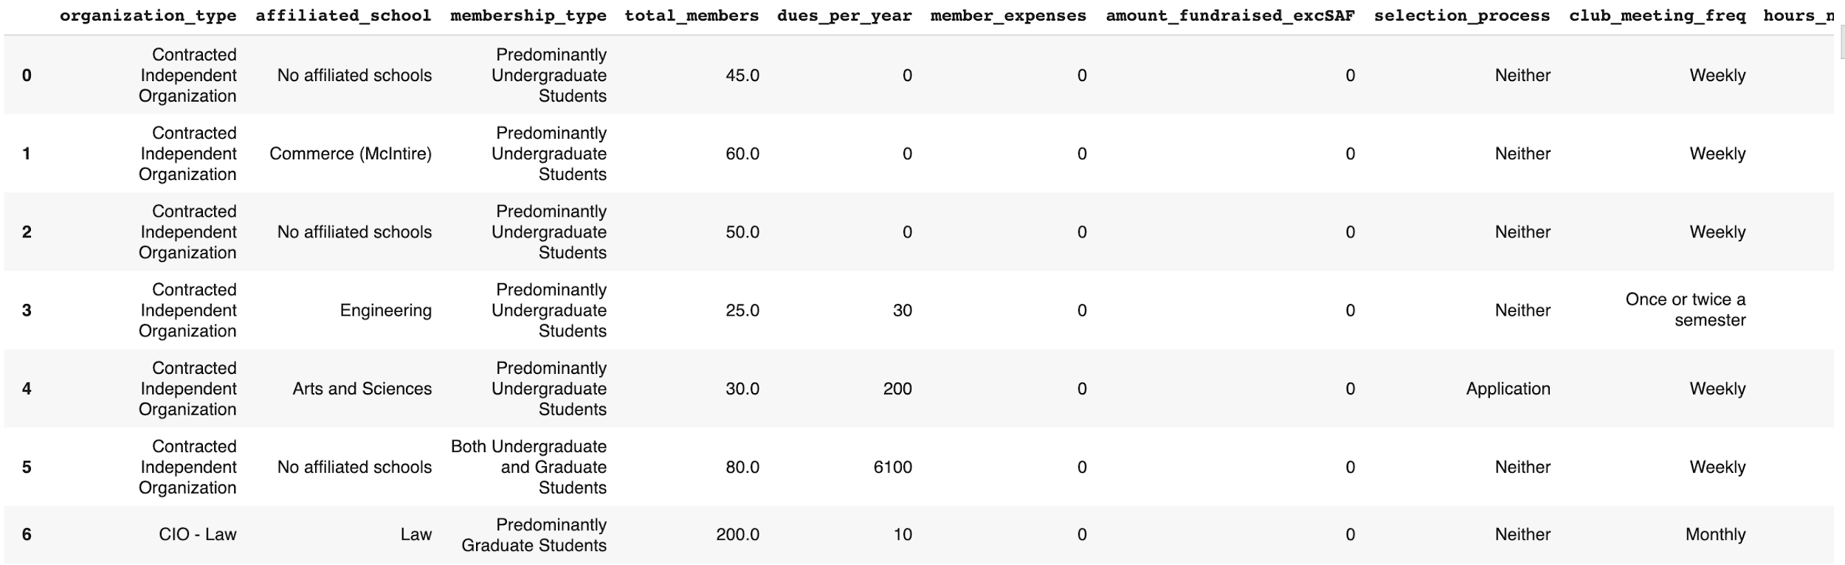
Cleaning
The cleaned dataset
Notes:
Ayoub

Slide 12
Clustering
We aimed to find any kind of similarity between the CIOs by using K-Means to group the CIOs into four clusters.
The columns we ended up using for K-Means were
Notes:
Andrew Lin

Slide 13
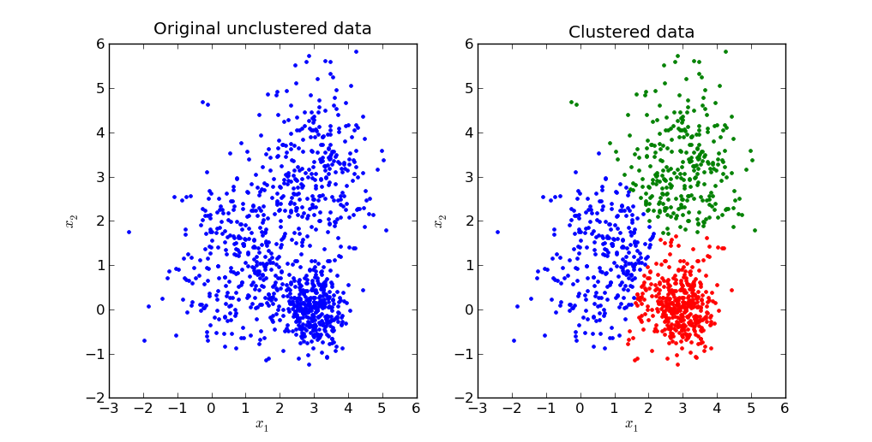
What is K-Means
Notes:
Andrew

Slide 14
Visualizations
Notes:
Kaleb

Slide 15
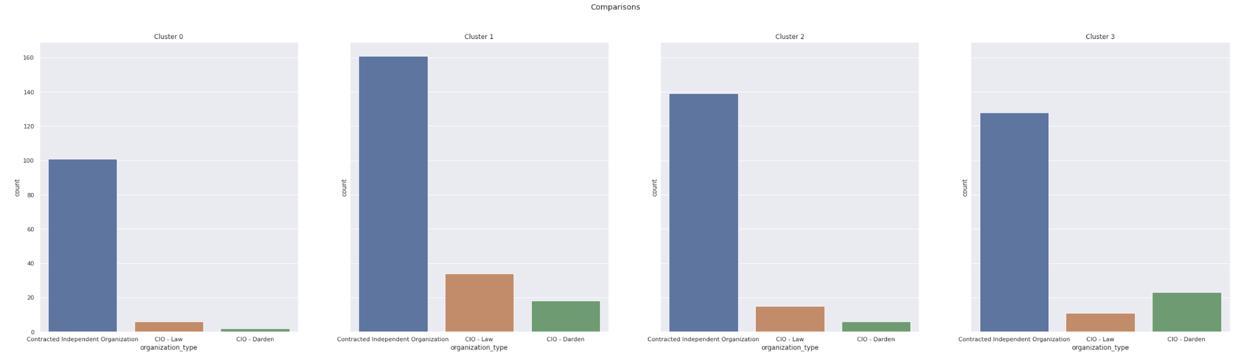
Organization Type
Notes:
Kaleb
Cluster 1/3 looks like Grad school

Slide 16
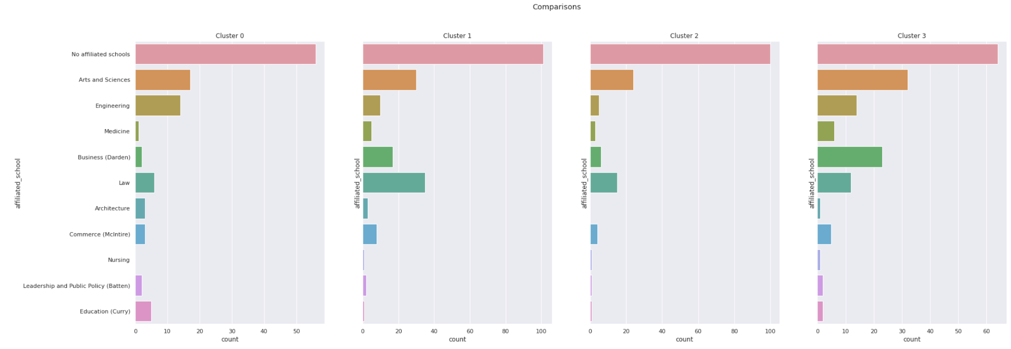
Affiliated School
Notes:
Kaleb

Slide 17
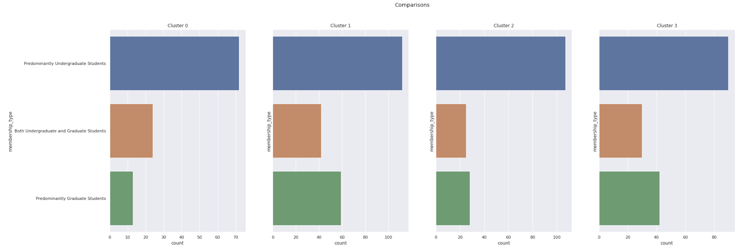
Membership Type
Notes:
Kaleb

Slide 18
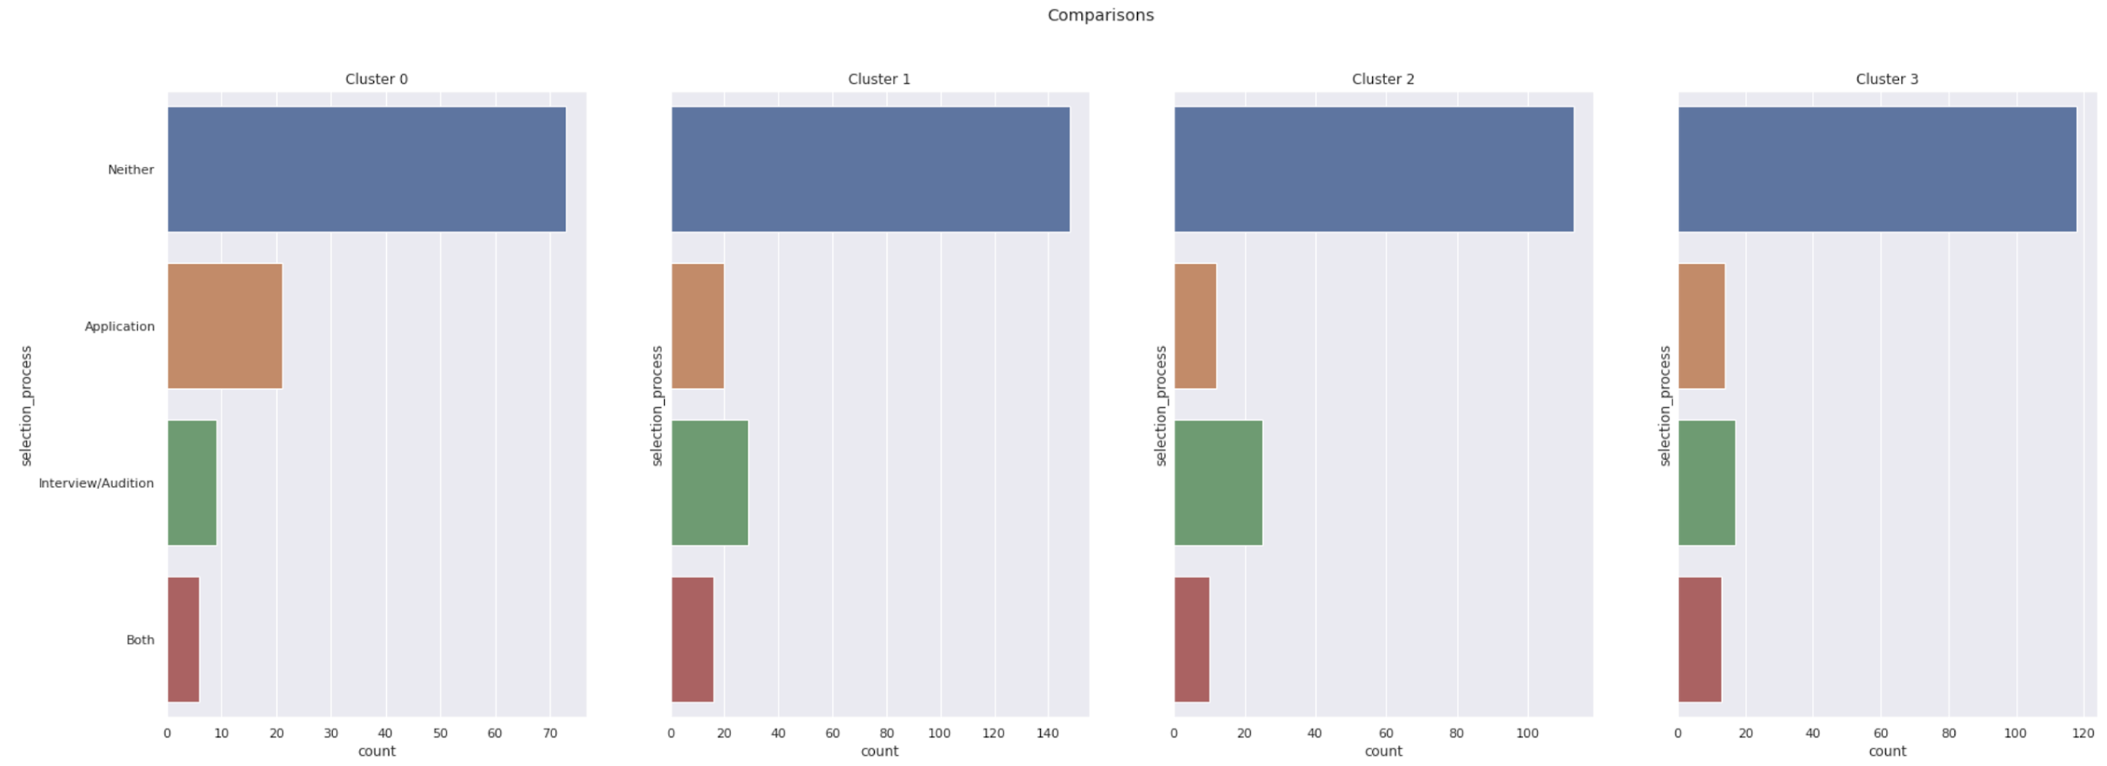
Selection Process
Notes:
Kaleb
Cluster 0 Application

Slide 19
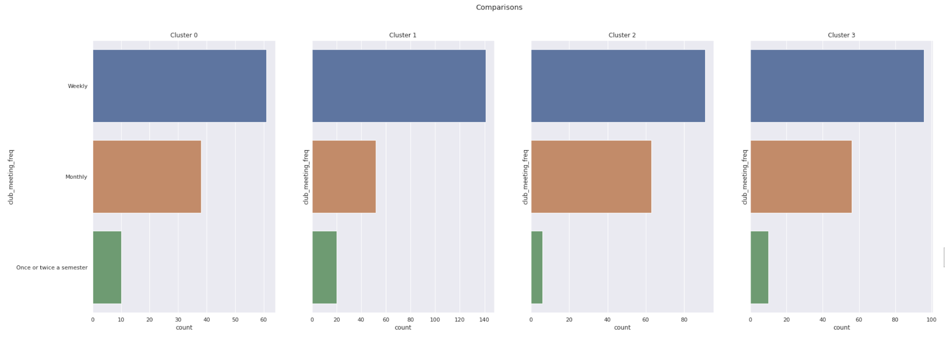
Club Meeting Frequency
Notes:
Kaleb
Cluster 1 lot on monthly

Slide 20
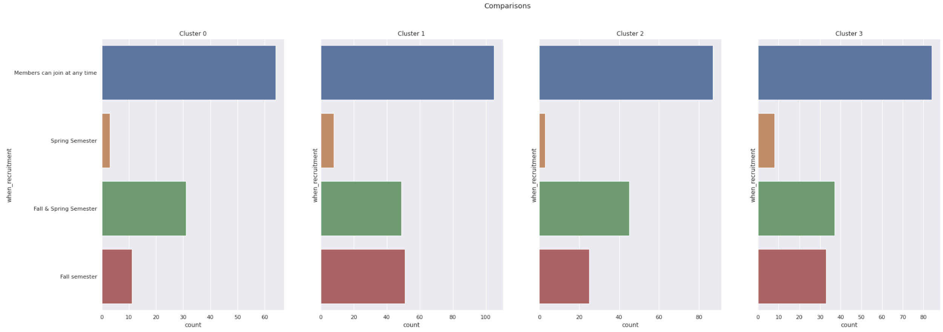
Recruitment start date
Notes:
Kaleb
Cluster 1 brings in a lot of fall semester only clubs

Slide 21
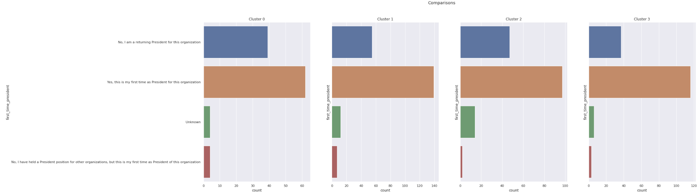
First Time President?
Notes:
Kaleb
Cluster 0 appears to have a balance of new presidents and old presidents

Slide 22
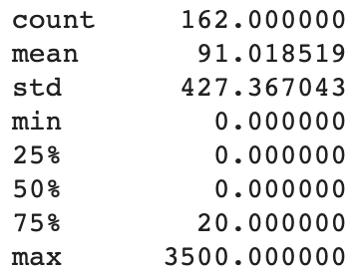
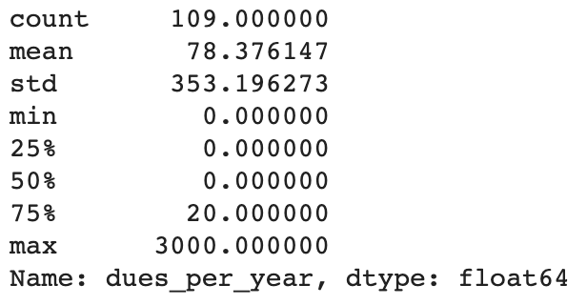
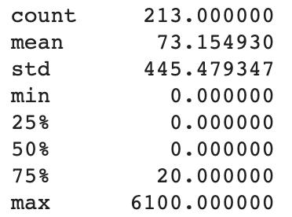
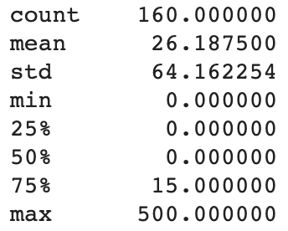
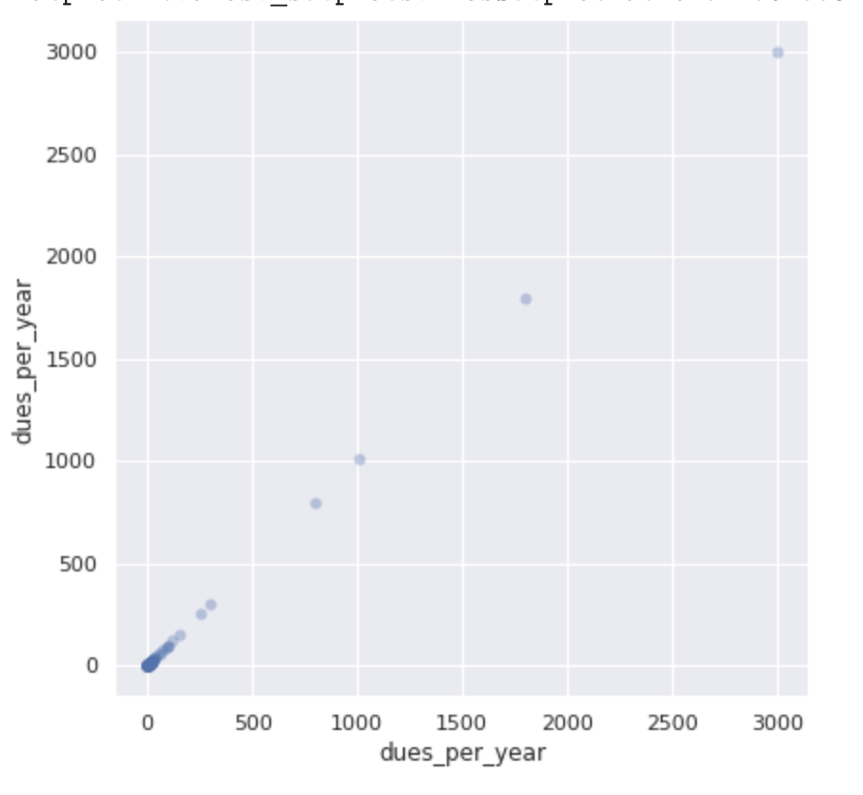
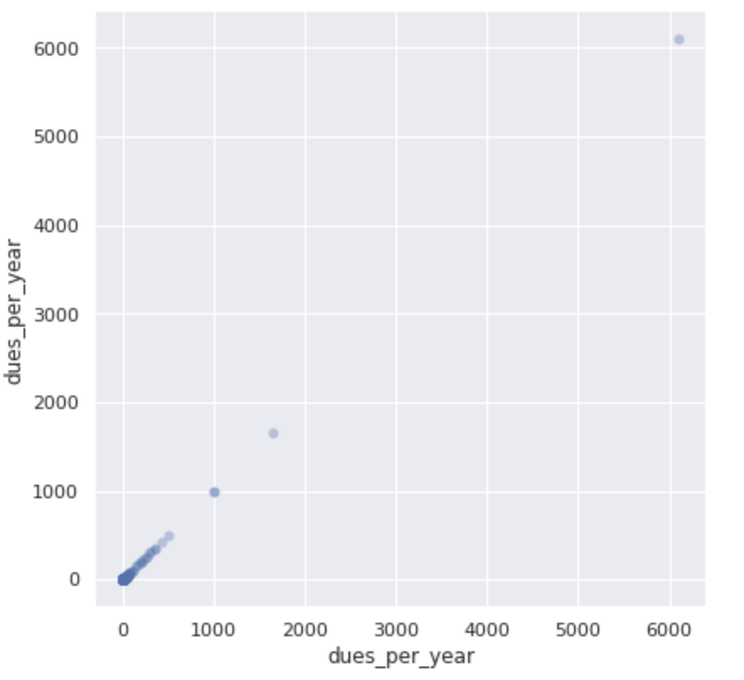
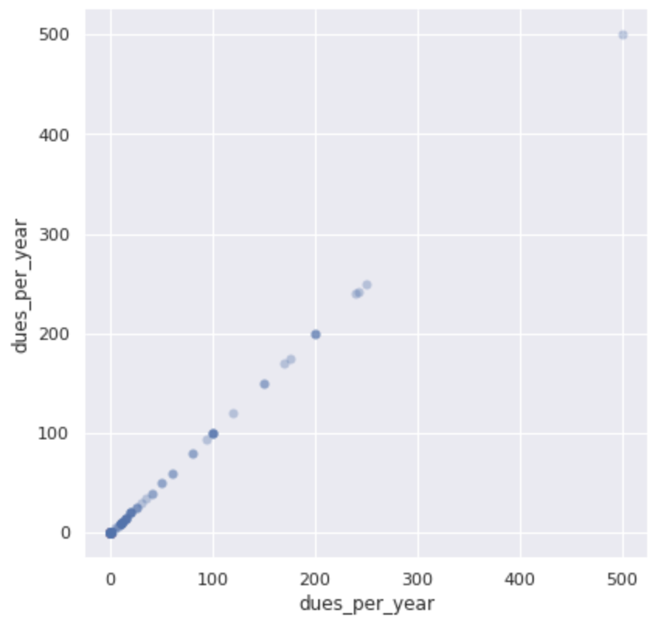
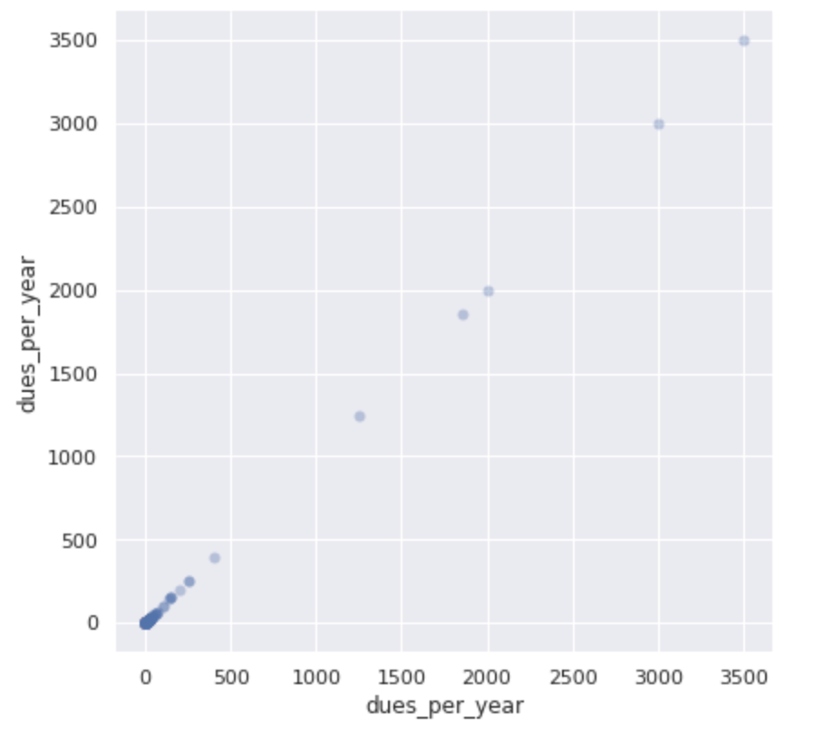
Dues Per Year
Cluster 0 Cluster 1 Cluster 2 Cluster 3
Notes:
Ali Clubs in Cluster 2 generally have the least amount of dues per year

Slide 23
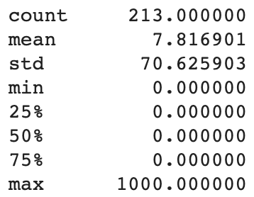
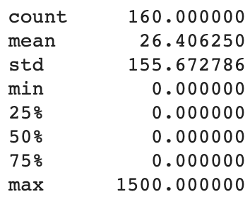
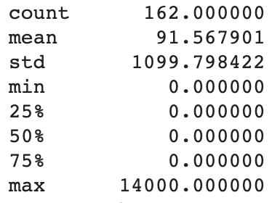
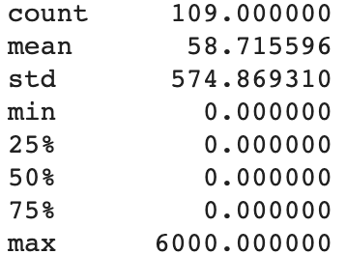
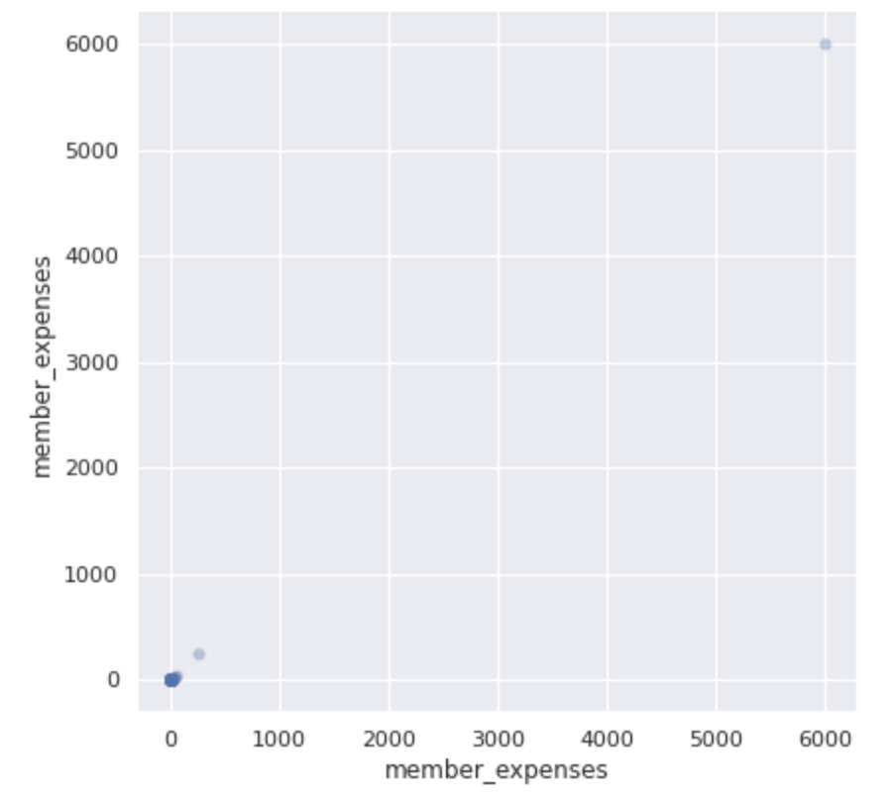
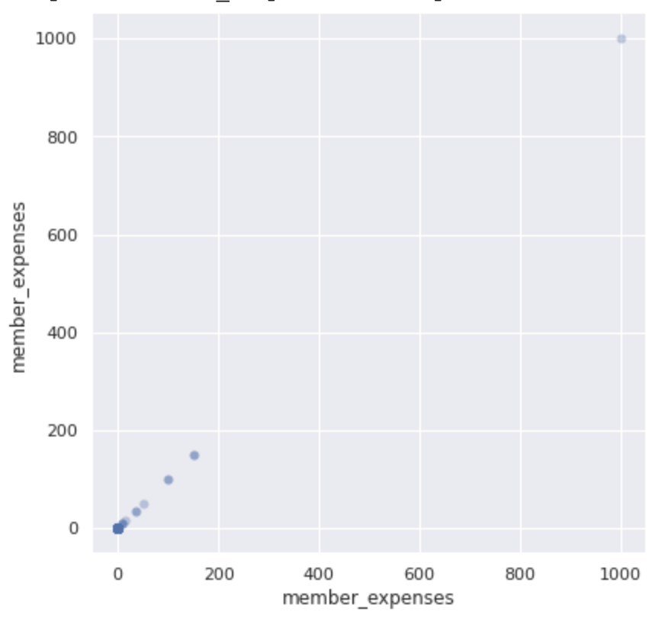
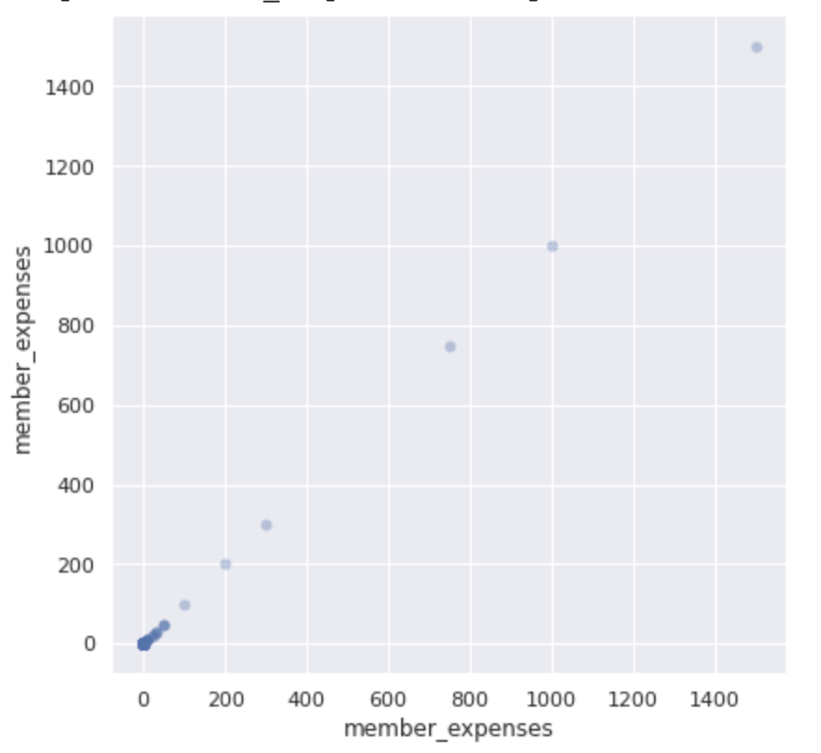
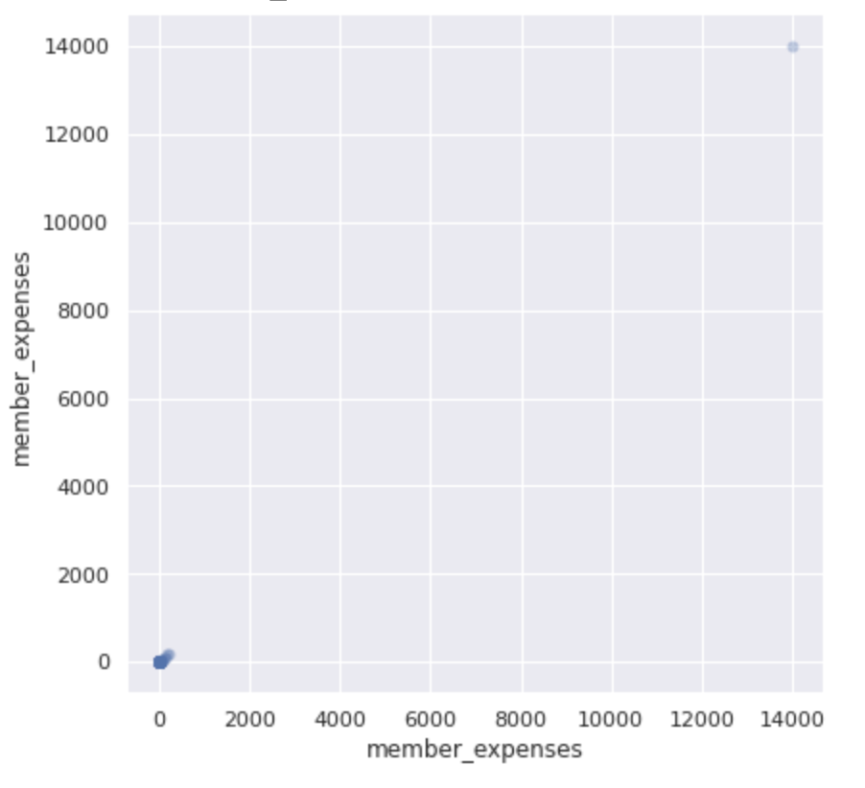
Member Expenses
Cluster 0 Cluster 1 Cluster 2 Cluster 3
Notes:
Ali Clubs in cluster 1 tend to have the lowest member expenses

Slide 24
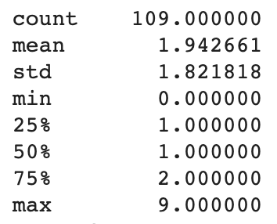
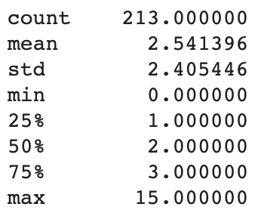
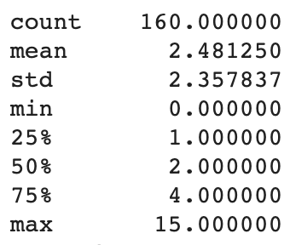
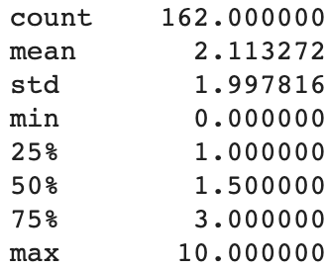
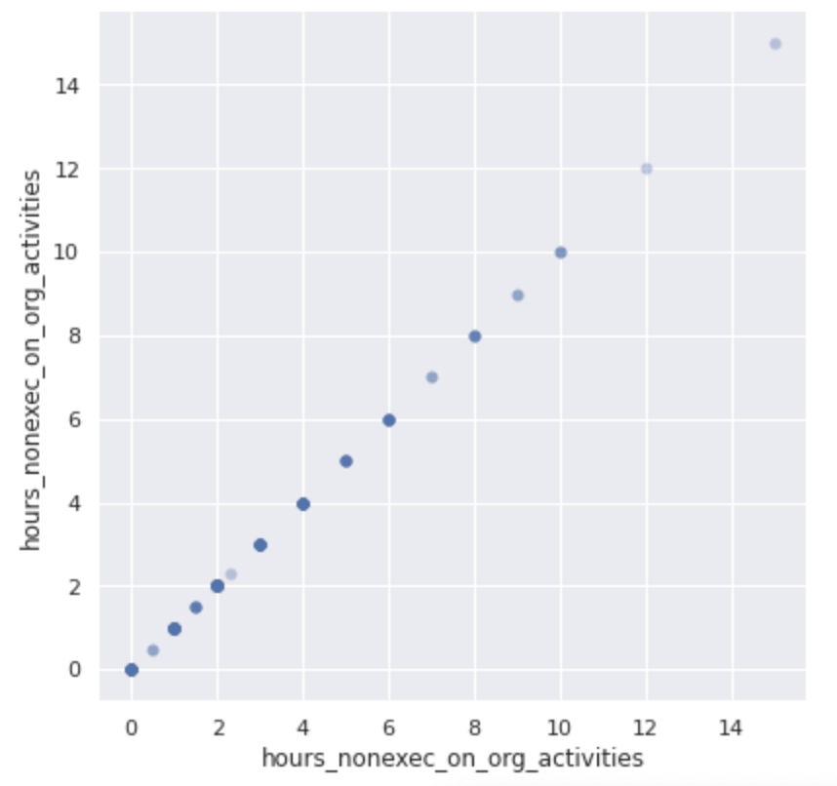
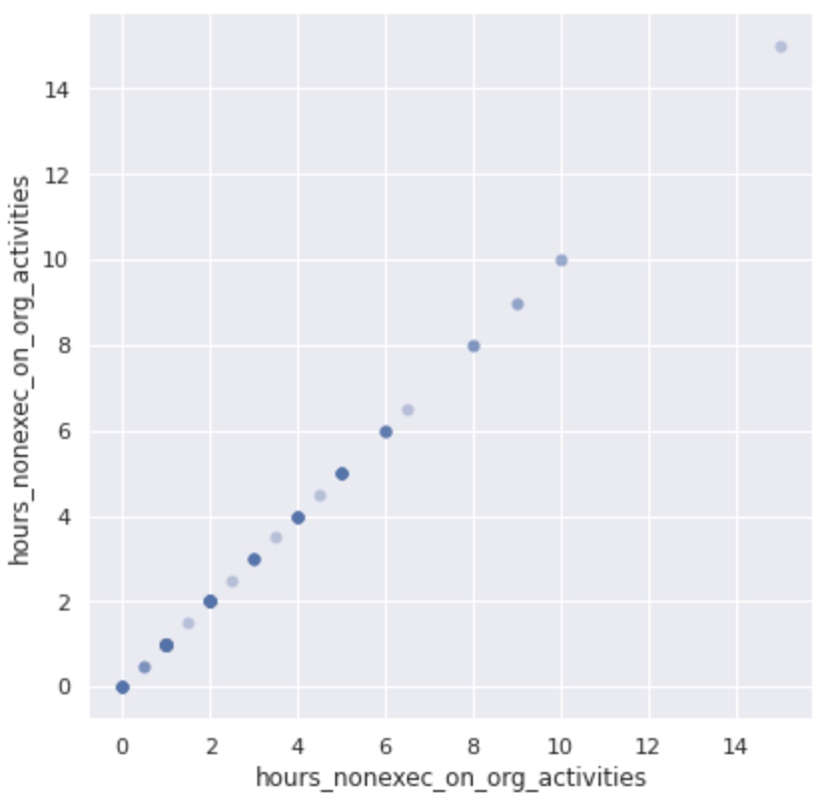
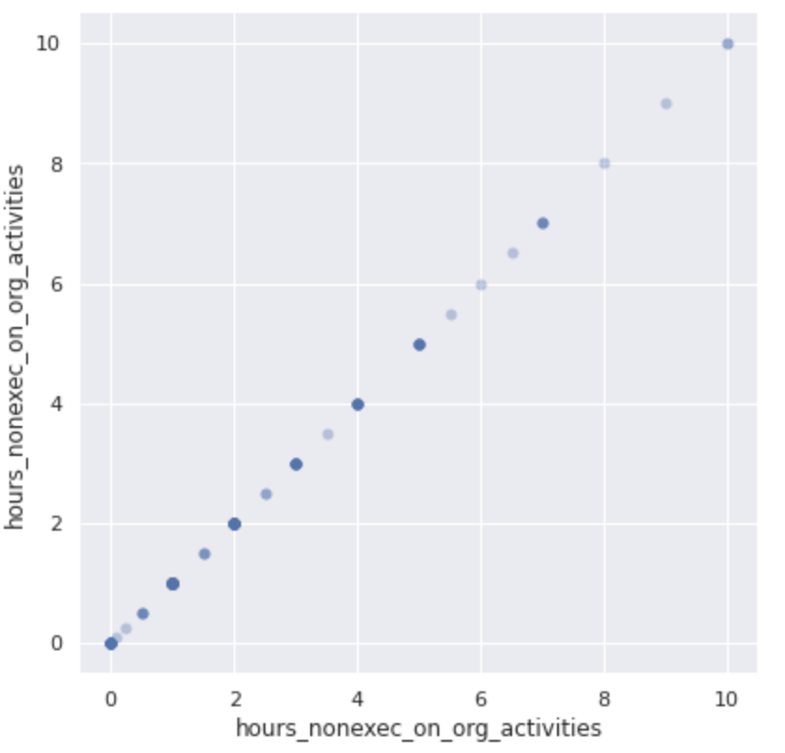
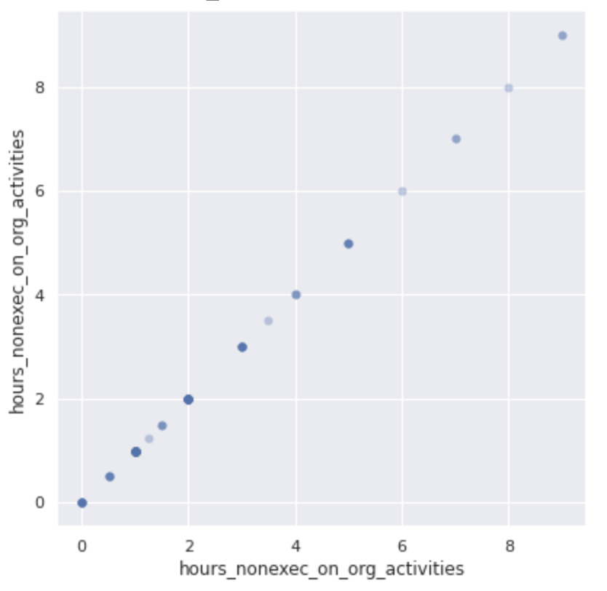
Hours on Non-Executive Organization Activities
Cluster 0 Cluster 1 Cluster 2 Cluster 3
Notes:
Ali - We found very little difference between clusters in regards to non-executive organization activites

Slide 25
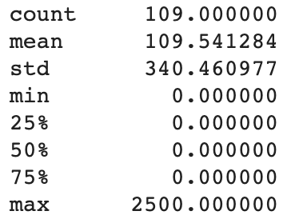
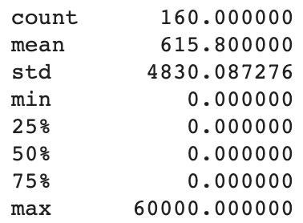
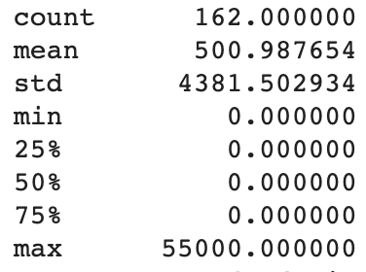
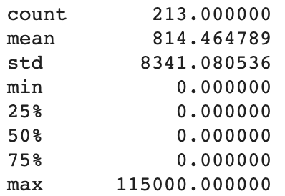
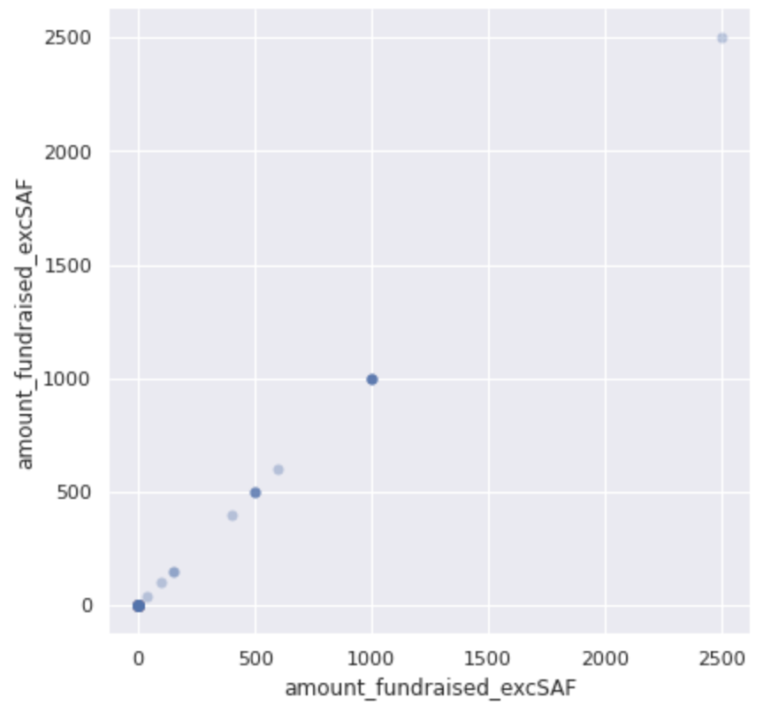
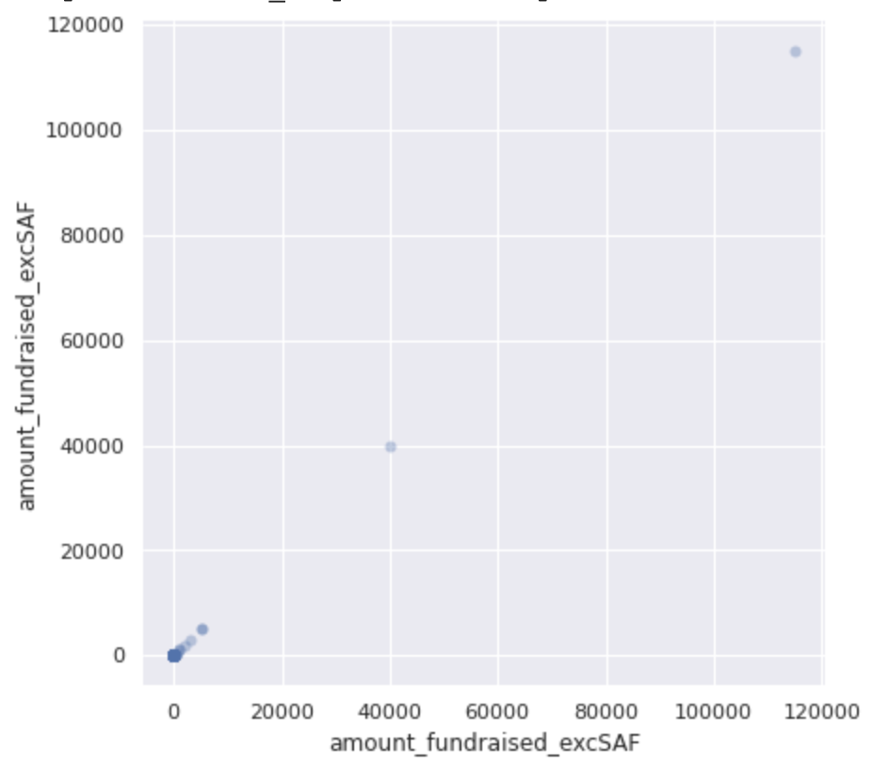
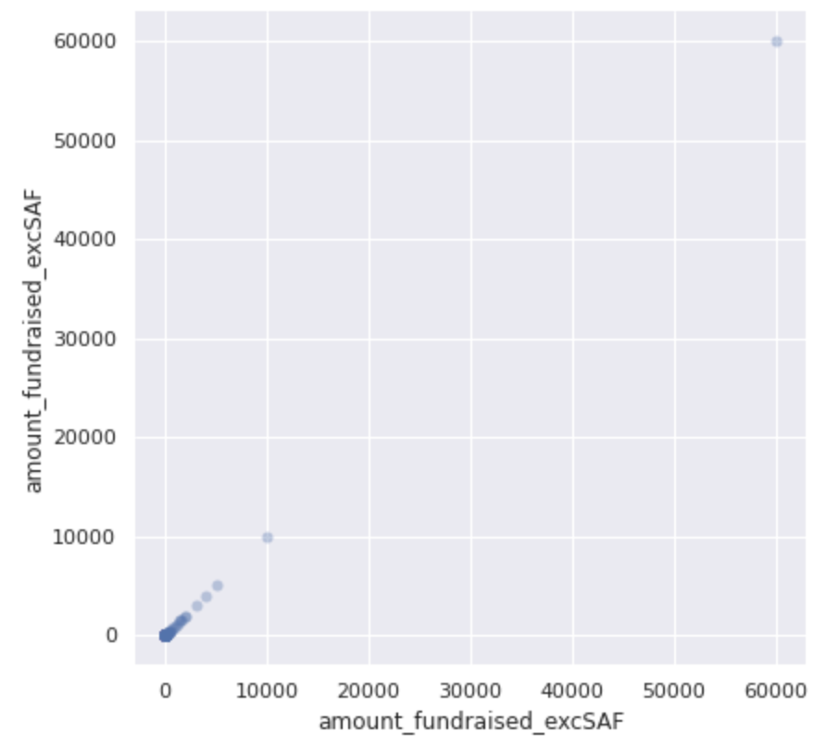
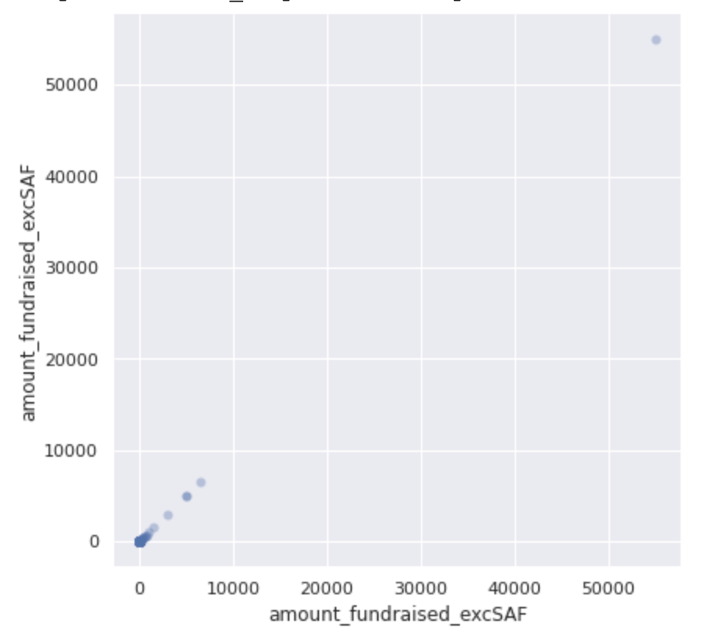
Amount Fundraised Except from SAF
Cluster 0 Cluster 1 Cluster 2 Cluster 3
Notes:
Ali- We found that cluster 2 had the highest average amount fundraised.

Slide 26

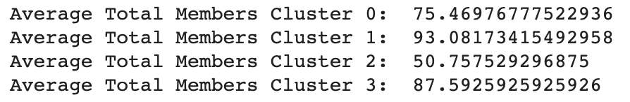
Average Total Membership in Clubs for Each Cluster
Notes:
Ali Cluster 1 has the highest average total members

Slide 27
Insights

Slide 28
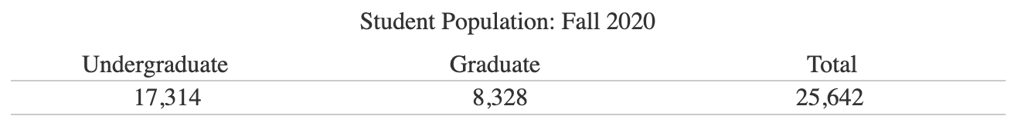
How many clubs are students involved with on average?
#Clubs
Total Predominantly Graduate Student Clubs Membership: 13,106
Total Predominantly Undergraduate Student Clubs Membership: 28,317
Total Both Undergrad and Grad Student Clubs Membership: 8,940
142
381
121
Grad Student Clubs = 13106 / 8328 = 1.57 clubs per grad student
Undergrad Student Clubs = 28317 / 17314 = 1.64 clubs per undergrad student
Assuming ⅔ undergrad, ⅓ grad makeup:
Grad Student Clubs = (13106 + (⅓ * 8940) / 8328 = 1.93 clubs per grad student
Undergrad Student Clubs = (13106 + (⅔ * 8940) / 8328 = 1.98 clubs per undergrad student
Overall Participation: 1.96 clubs per student
Notes:
Ali Ibrahim

Slide 29

Each Cluster’s Normalized Mean For Each Feature
Organization Type: 19-21
Affiliated School: 22-32
Membership Type: 33-35
Selection Process: 36-39
Club Meeting Frequency: 40-42
When’s the Election: 43-52
When’s Recruiting: 53-56
Incoming or Returning Pres: 57-59
First-Time President: 60-62
Notes:
Andrew

Slide 30


Notes:
Andrew

Slide 31








Notes:
Andrew

Slide 32
Cluster 0
Highest Features
Motivating members
Holding members accountable
Developing mission/vision
Recruiting new members
Marketing
Notes:
Andrew

Slide 33
Cluster 1
Highest Feature:
Either well-off or inactive
Notes:
Andrew

Slide 34
Cluster 2
Highest Feature:
Recruiting Members
Notes:
Andrew

Slide 35
Cluster 3
Highest Features:
Collaboration
building/icebreakers
Sponsorships
Notes:
Andrew

Slide 36
Cluster 0:
Motivating members
Holding members accountable
Developing mission/vision
Recruiting new members
Marketing
Cluster 1:
Either well-off or inactive
Clubs in Cluster 0 seem to want to grow and maintain members.
Clubs in Cluster 2 seem established, but want to grow.
Clubs in Cluster 3 seem to want additional resources on team-building activities. These clubs could be looking to engage members of their club. This could also mean that these clubs want to place more emphasis on inclusion.
Cluster 2:
Recruiting Members
Cluster 3:
Collaboration
building/icebreakers
Sponsorships
Notes:
Andrew

Slide 37
Thank You!

